Slide 1
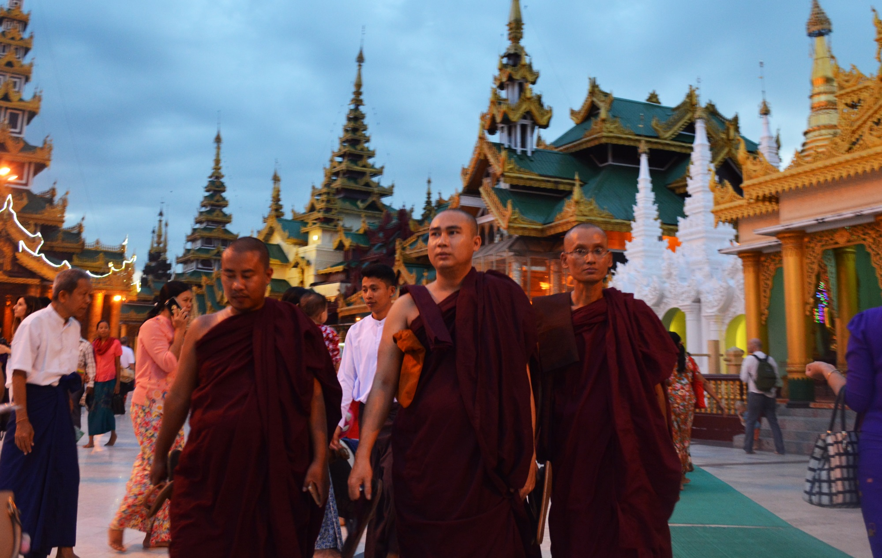
Theravada Buddhism

Slide 2
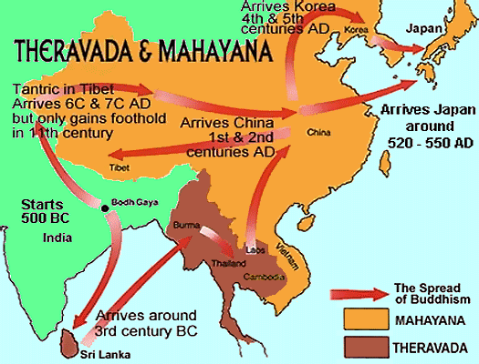
Theravada
Where did Theravada Spread

Slide 3
Theravada - Characteristic
Souces = Pali Canon Alone
Form = monastic
Sources | Pali Canon Alone
Form | Monastic [in Asia]
Inspiration | Siddhatha Gotoma [a guy]
Goal | Personal Nibbana
Means | Sila > Samadhi > Panna (Vipassana)
“The Way of the Elders” [also Hinayana]

Slide 4
Monastic Life
Monastic Schedule
Time | Activities
4:30 AM - 5:00 AM | Wake-up
5:00 AM - 6:00 AM | Meditation & Chanting
6:00 AM - 6:30 AM | Begging
7:00 AM - 8:00 AM | Breakfast/Community Clean-Up
8:30 AM – 10:30 AM | Work Period
10:45 AM – 11:00AM | Preparation for Lunch
11:00 AM – 1:00 PM | Chanting, Lunch. Clean-up
Time | Activities
1:00 PM – 6:00 PM | Study or Work Period
6:00 PM – 8:00 PM | Meditation & Chanting
8:00 Pm – 9:00 PM | Personal / Study Time
9:00 - | Bedtime

Slide 5
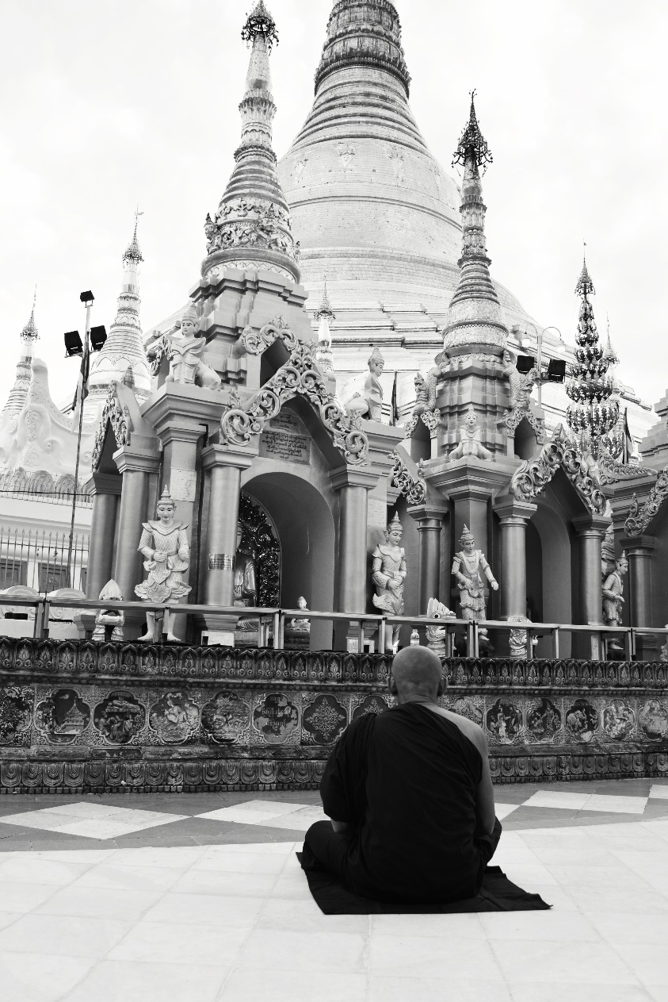
Monastic Life
Meditation (Shwedagon Pagoda, Yangon, Burma)

Slide 6
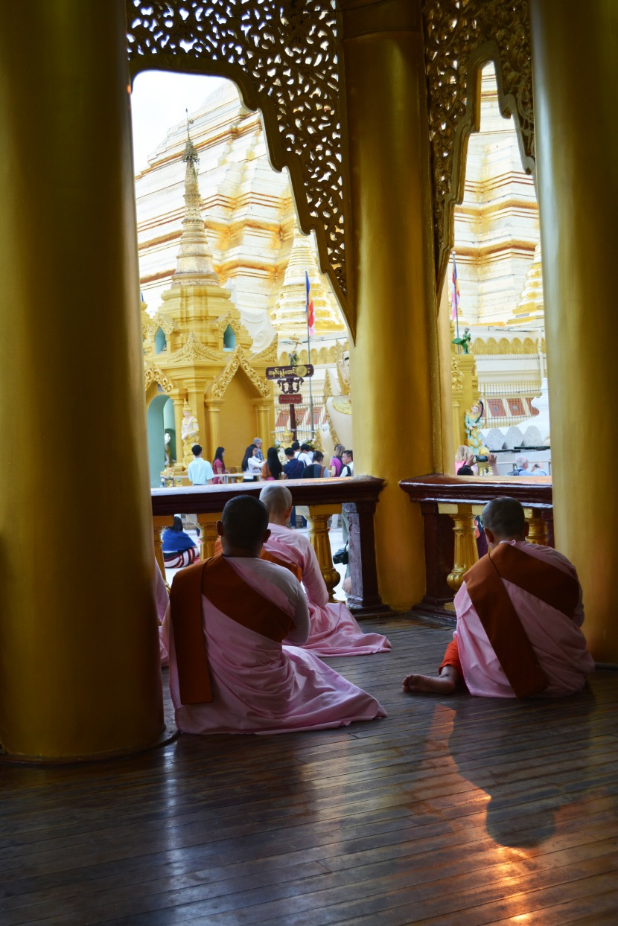
Monastic Life
Meditation (Shwedagon Pagoda, Yangon, Burma)

Slide 7
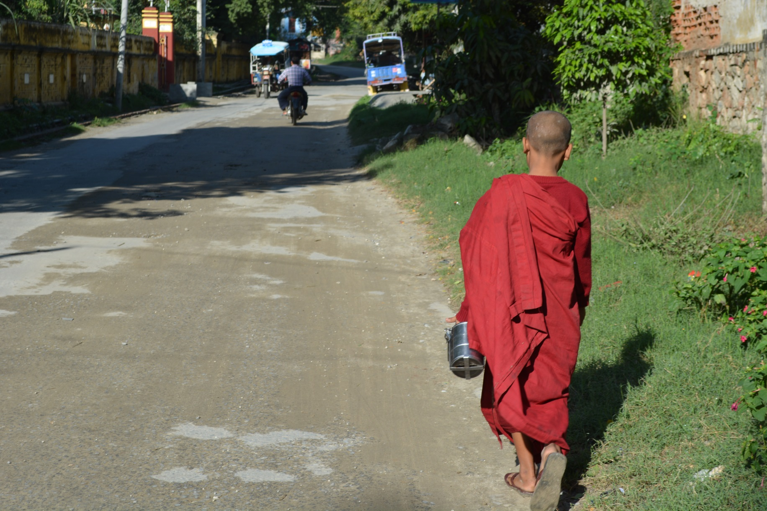
Monastic Life
Begging (Mandalay, Burma)

Slide 8
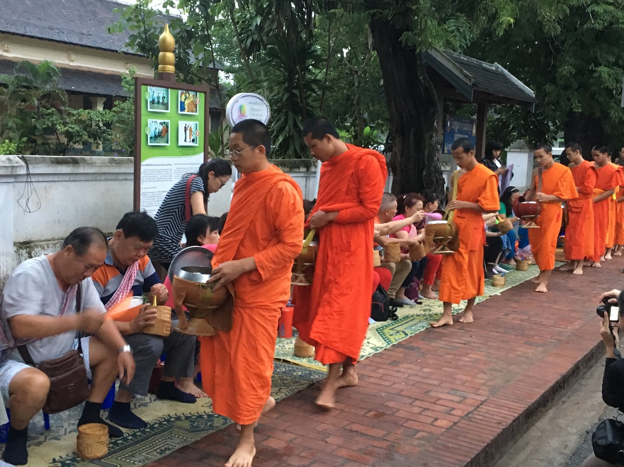
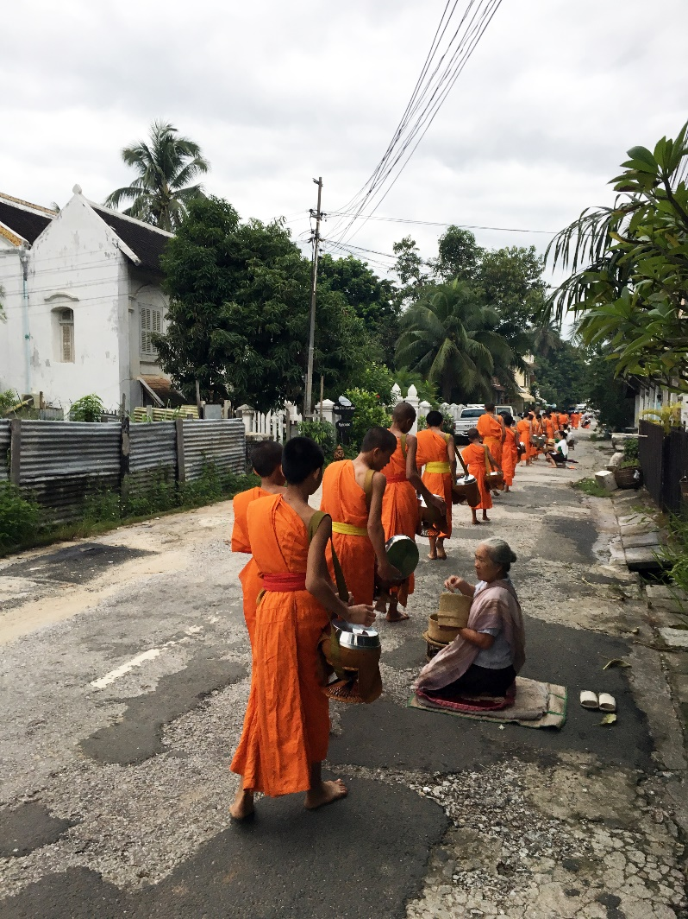
Monastic Life
Begging (Luang Prabang, Loas)

Slide 9
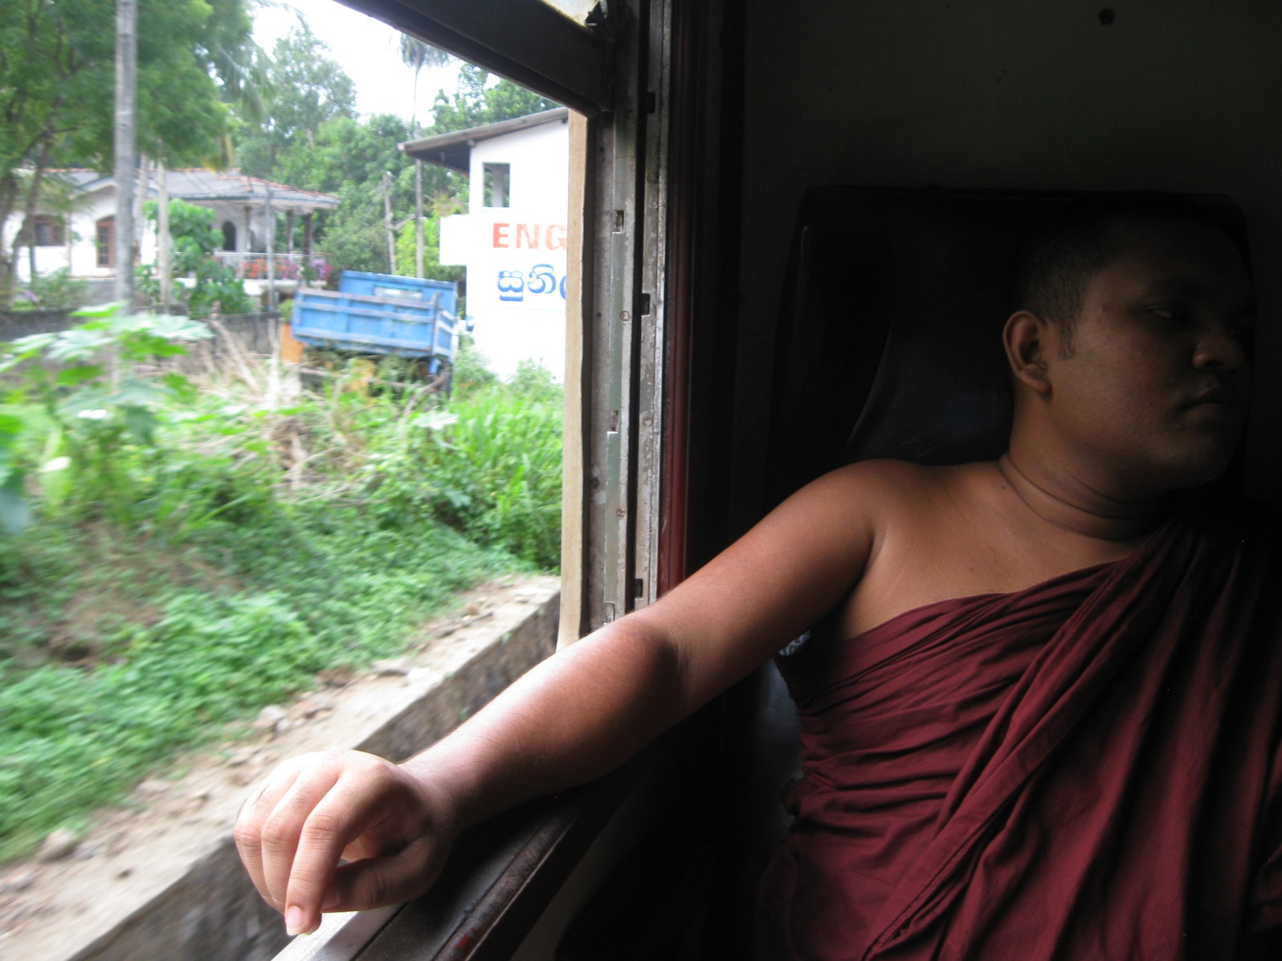
Monastic Life
Accepting Offerings (Colombo, Sri Lanka)

Slide 10
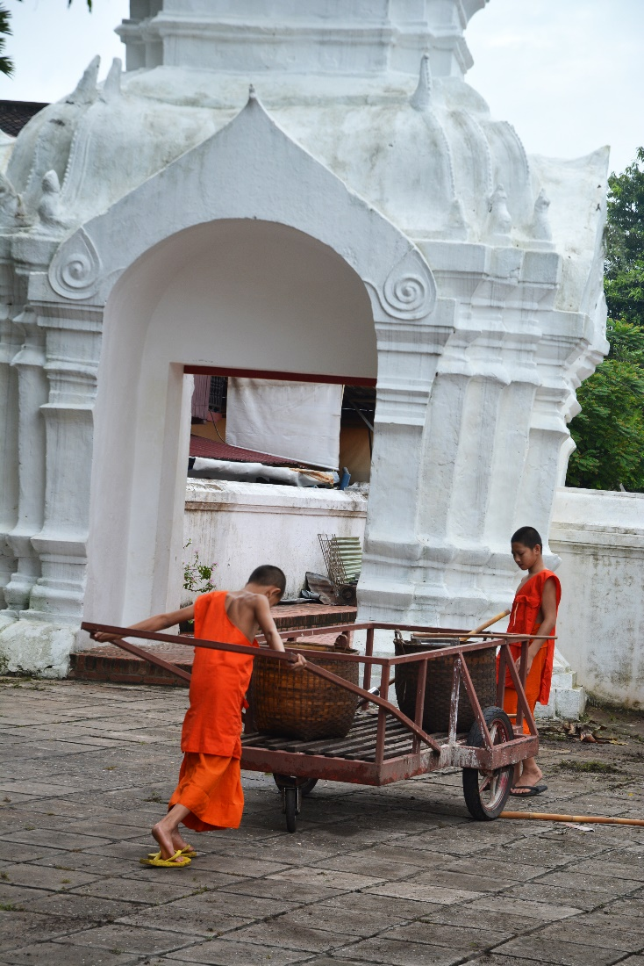
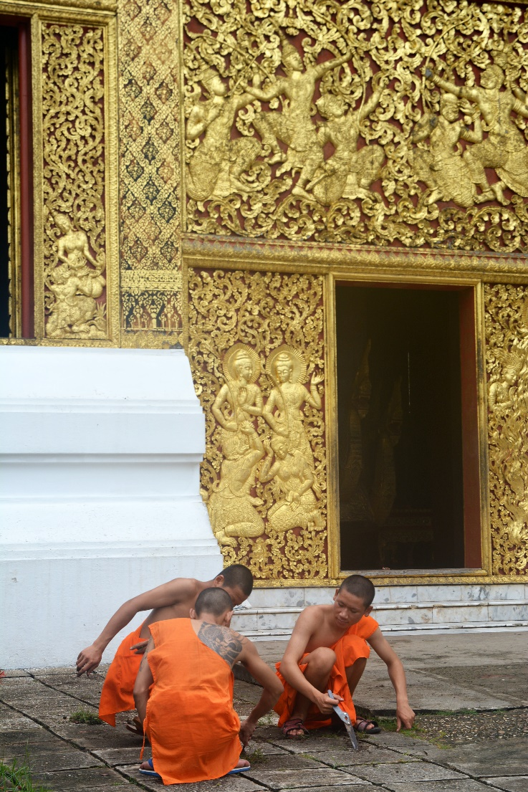
Monastic Life
Work Period (Luang Prabang, Laos)

Slide 11
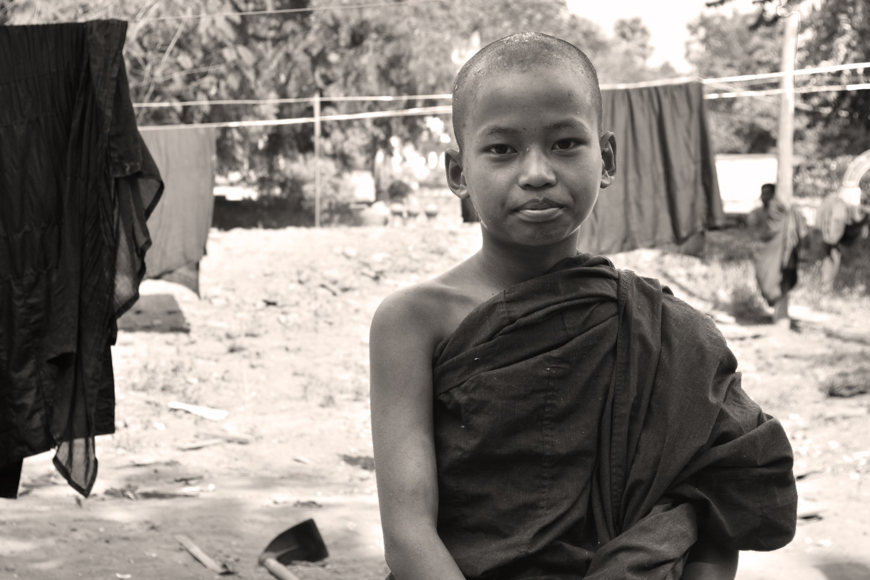
Monastic Life
Work Period(Mandalay, Burma)

Slide 12
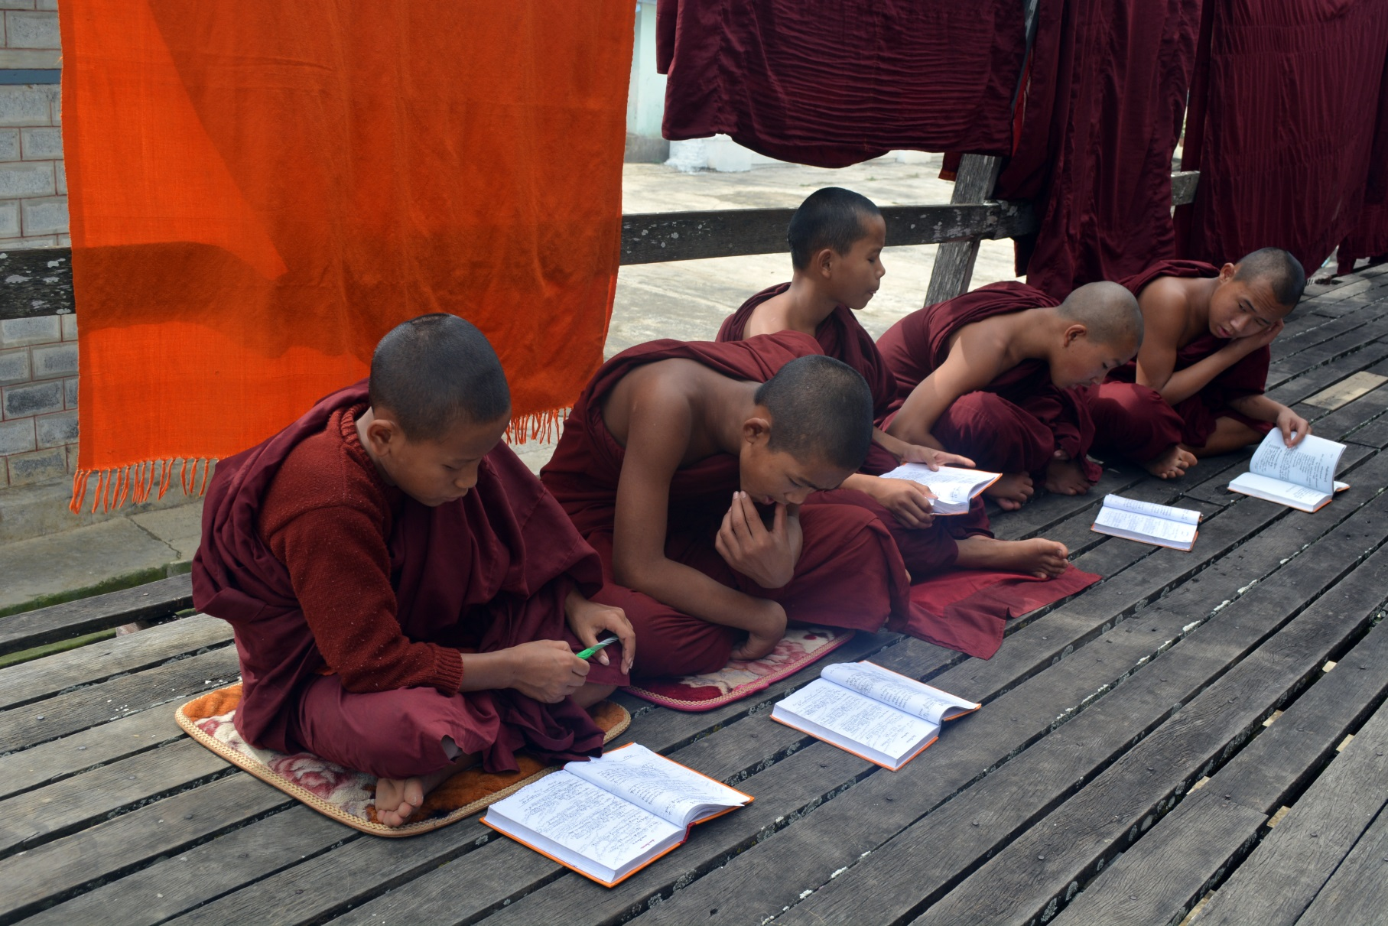
Monastic Life
Study (Inle, Burma)

Slide 13
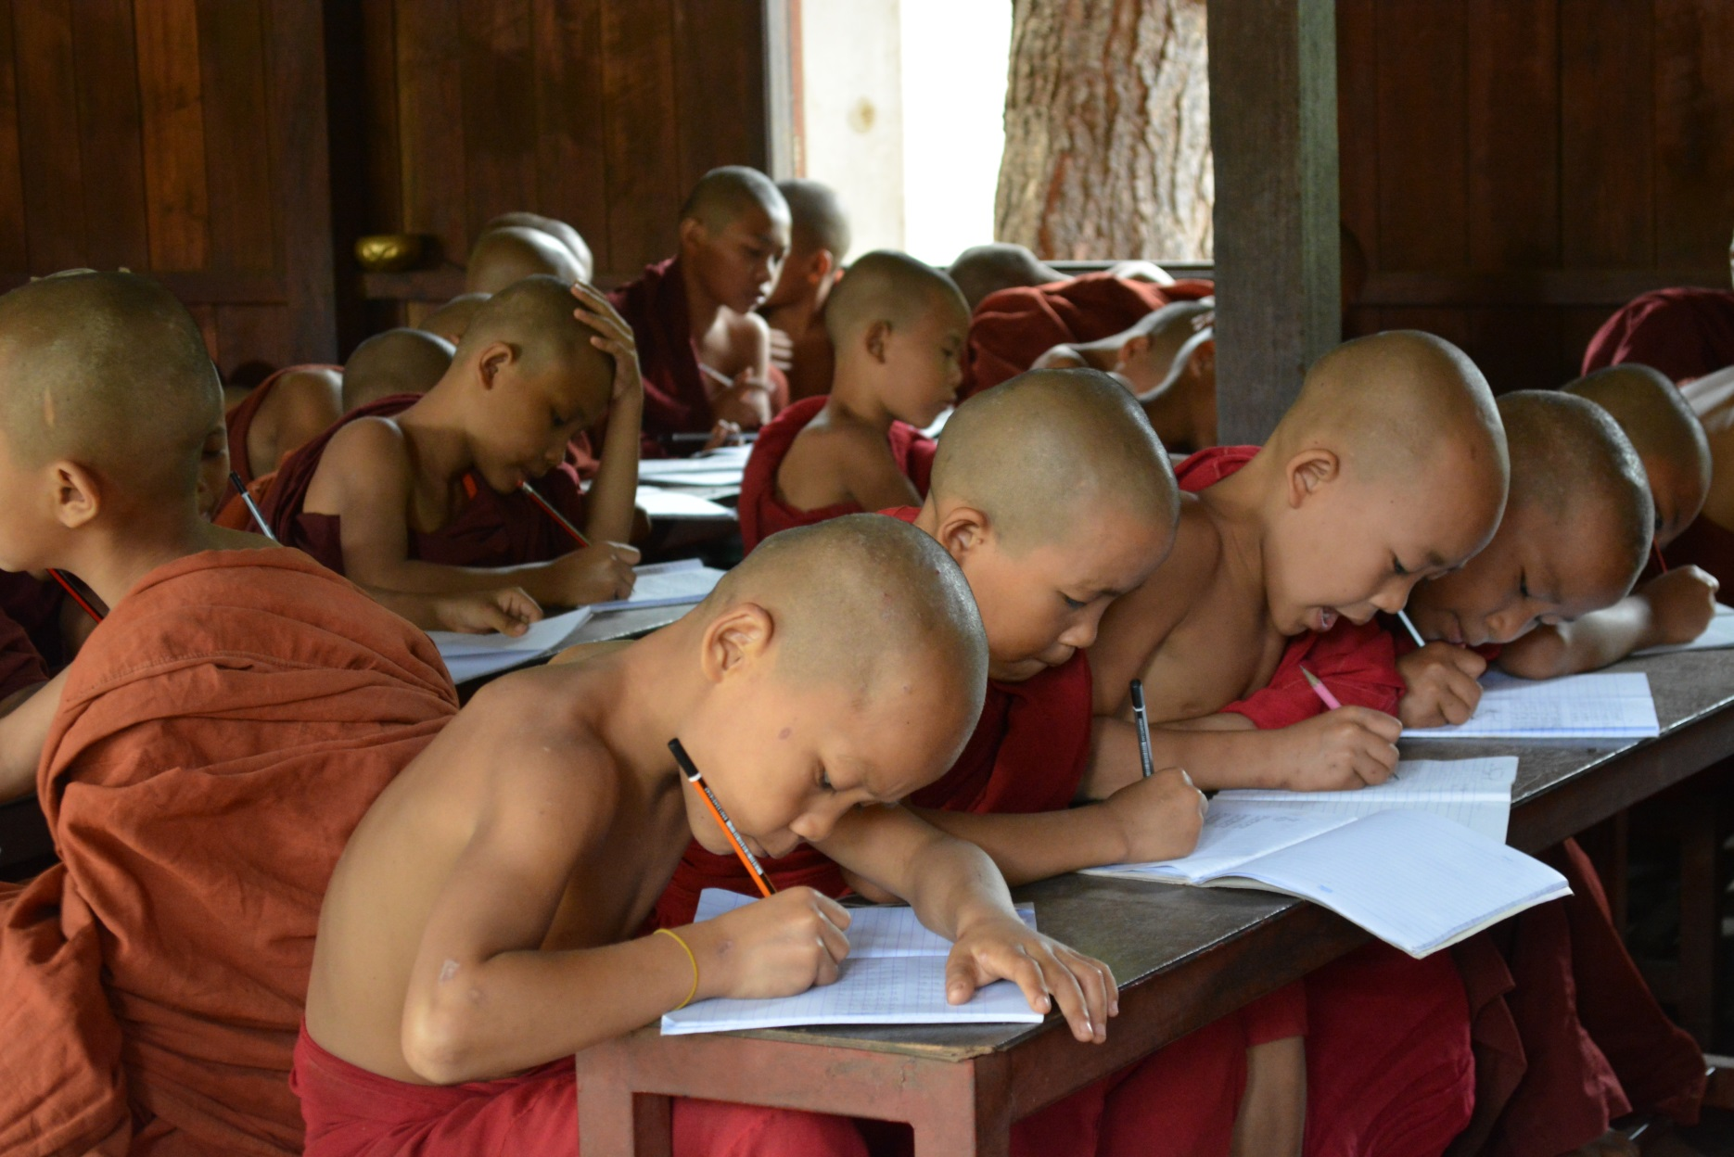
Monastic Life
Monastic School (Mandalay, Burma)

Slide 14
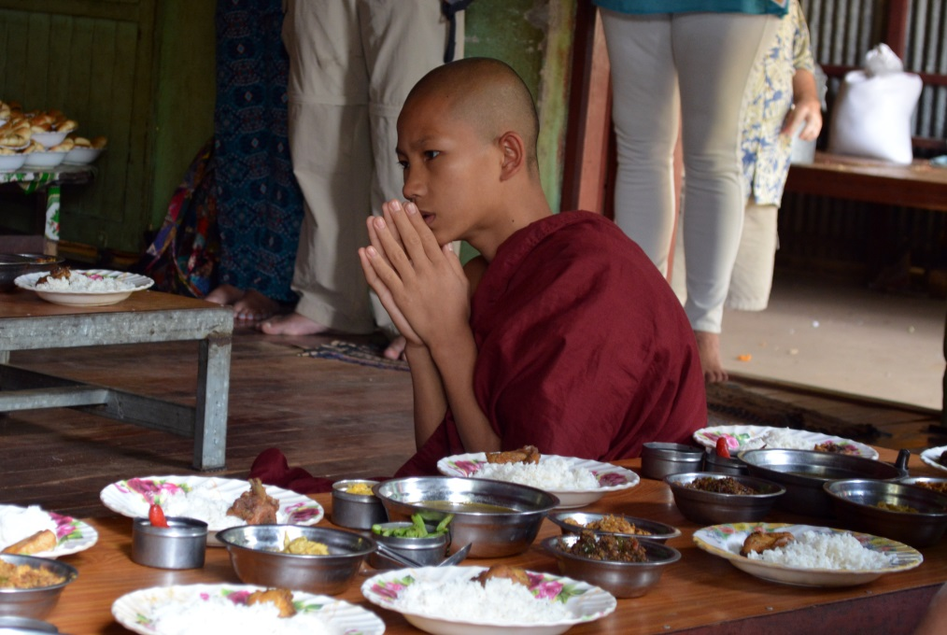
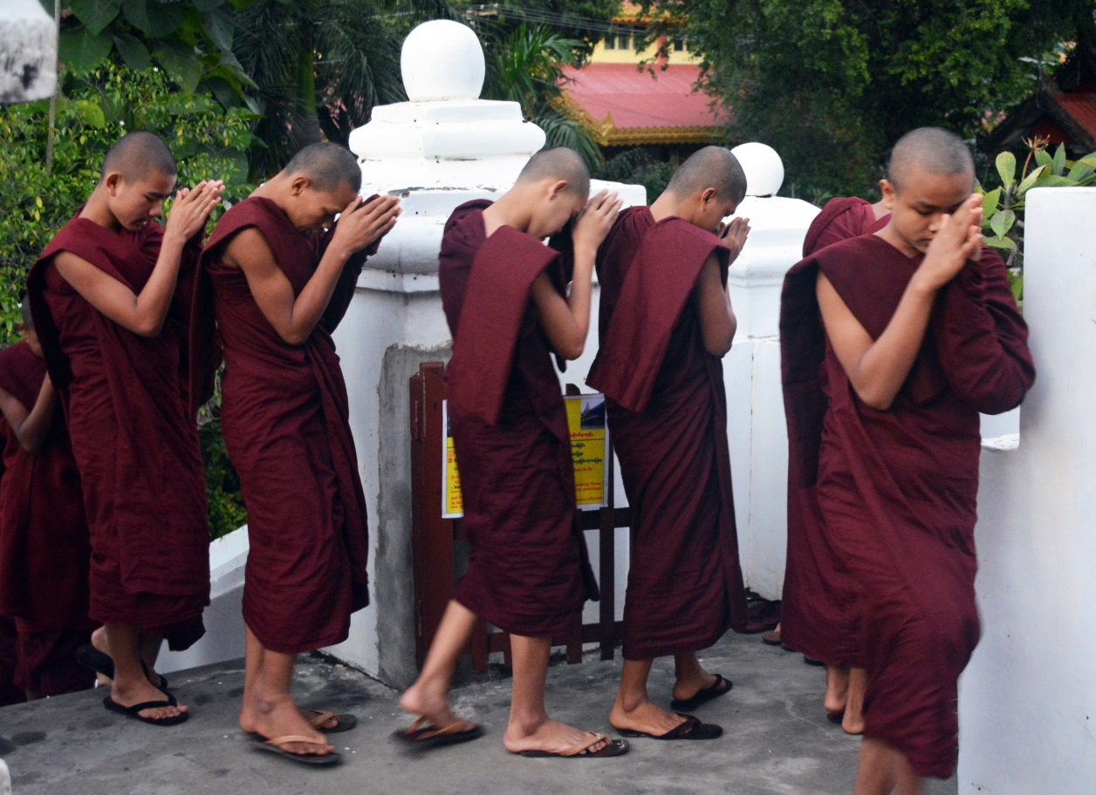
Monastic Life
Chanting (Mandalay, Burma)

Slide 15
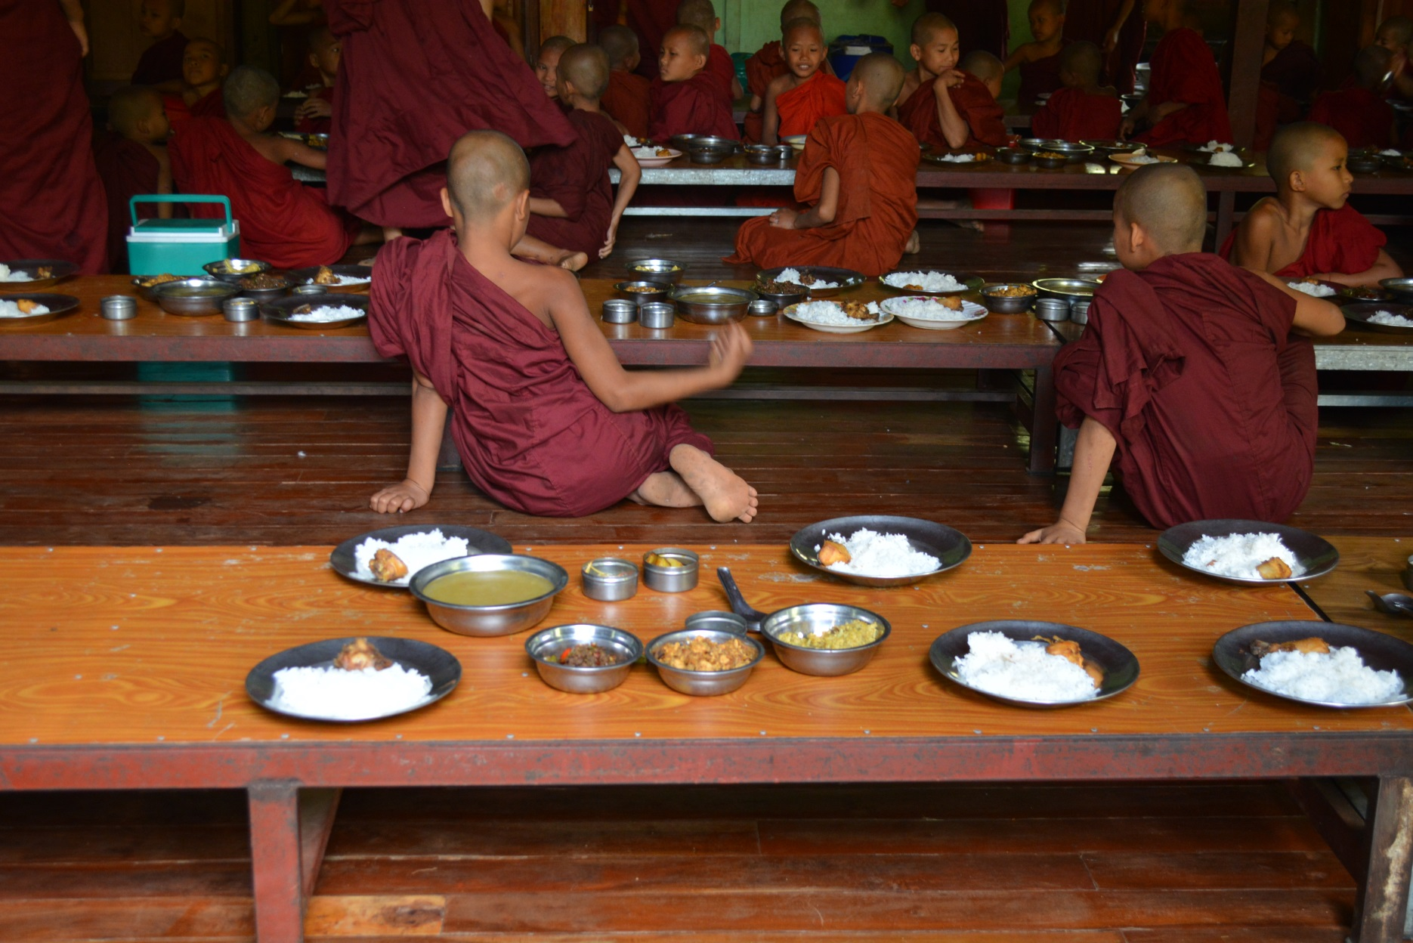
Monastic Life
Meals: Breakfast and Lunch Mandalay, Burma)

Slide 16
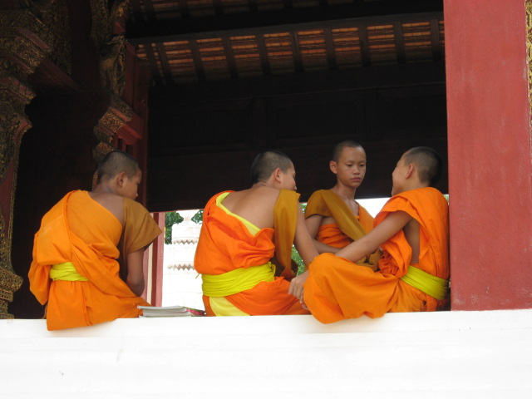
Monastic Life
Personal Time (Chiang Mai, Thailand)

Slide 17
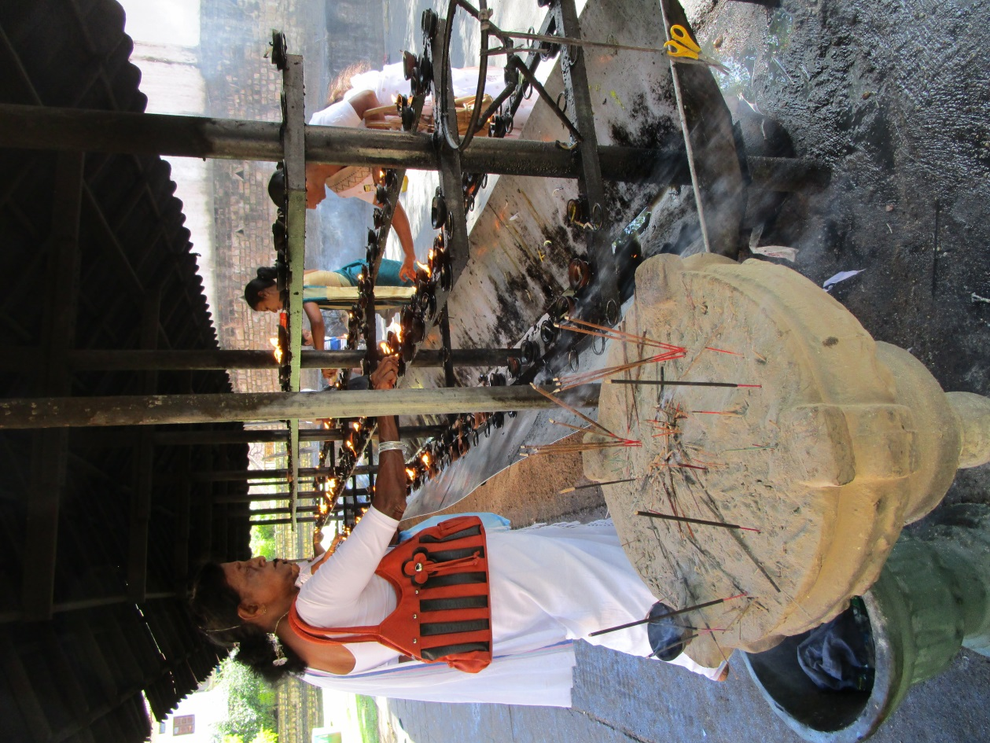
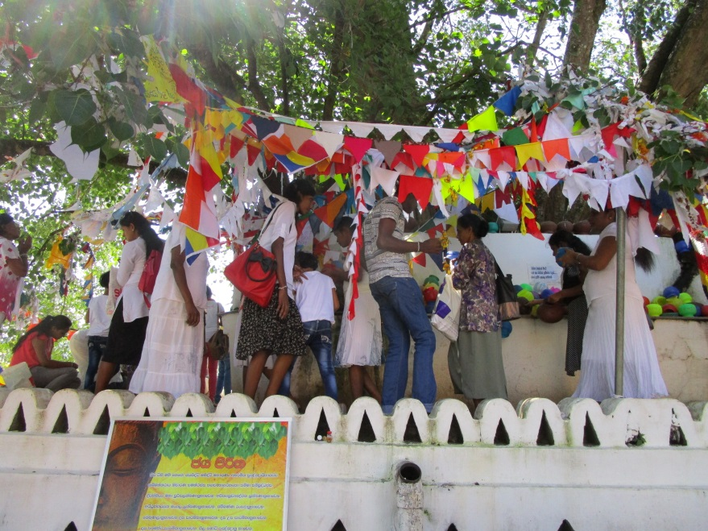
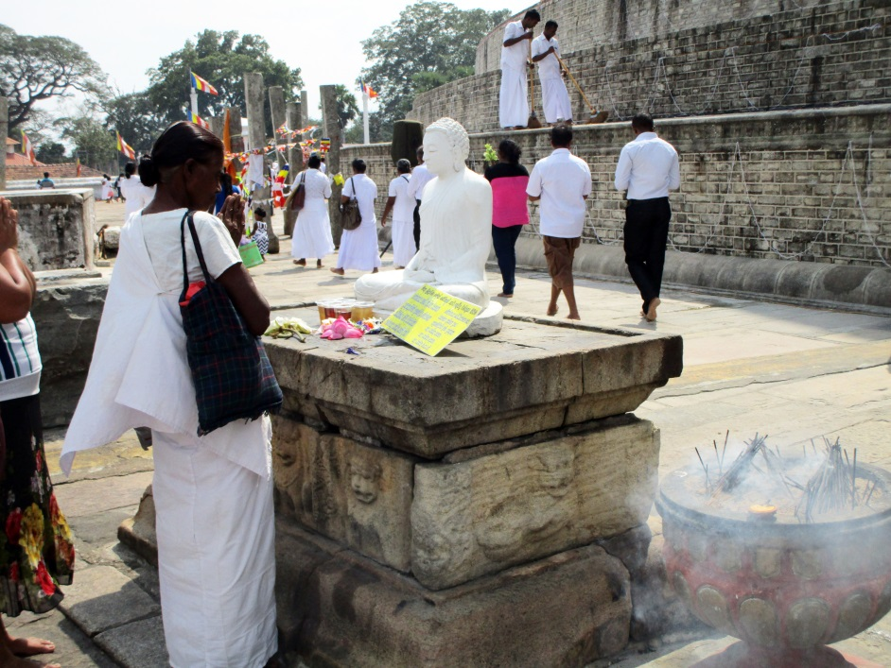
Lay Buddhist Practice
Devotional Activity (Sri Lanka)

Slide 18
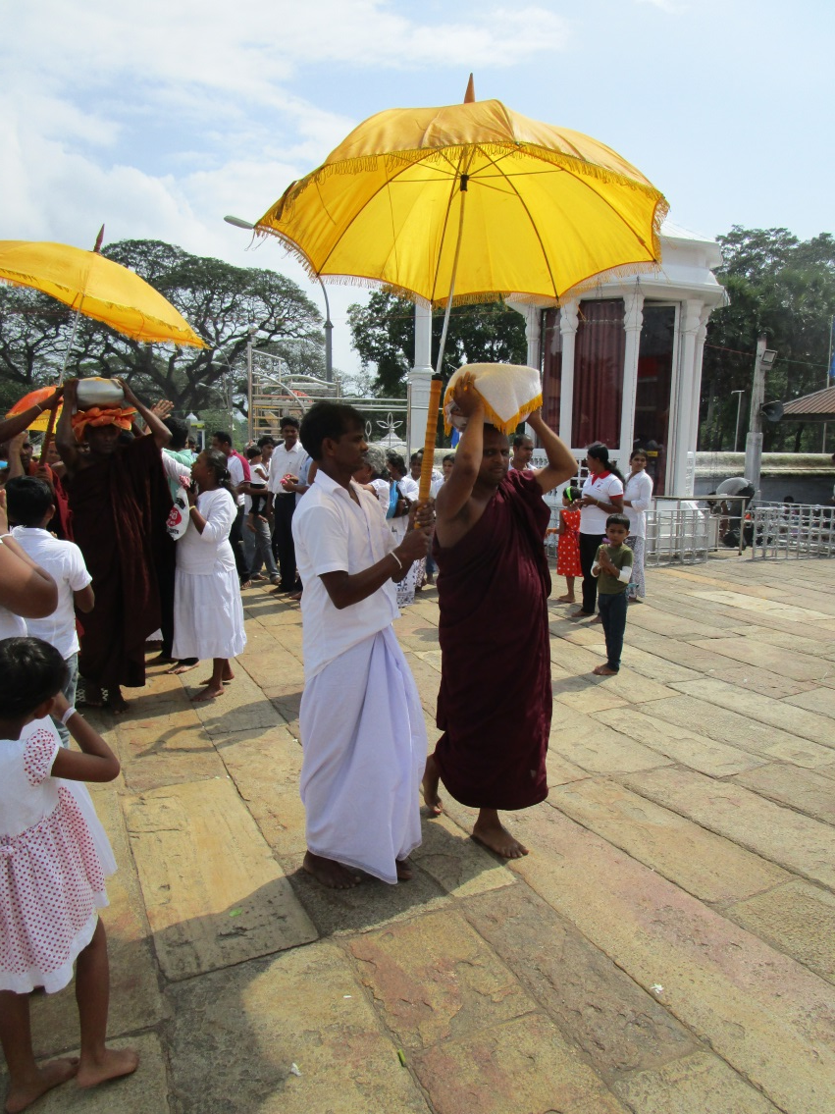
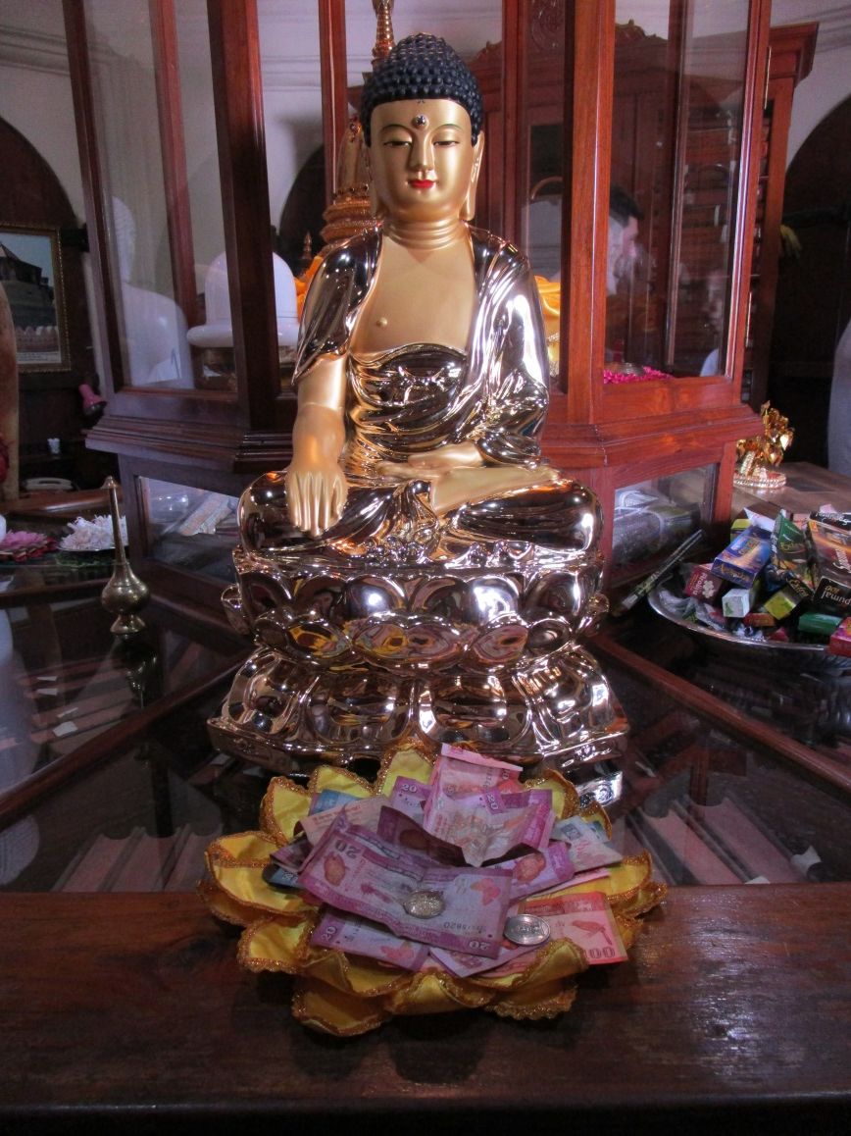
Lay Buddhist Practice
Supporting Monasteries (Kandy, Sri Lanka)

Slide 19
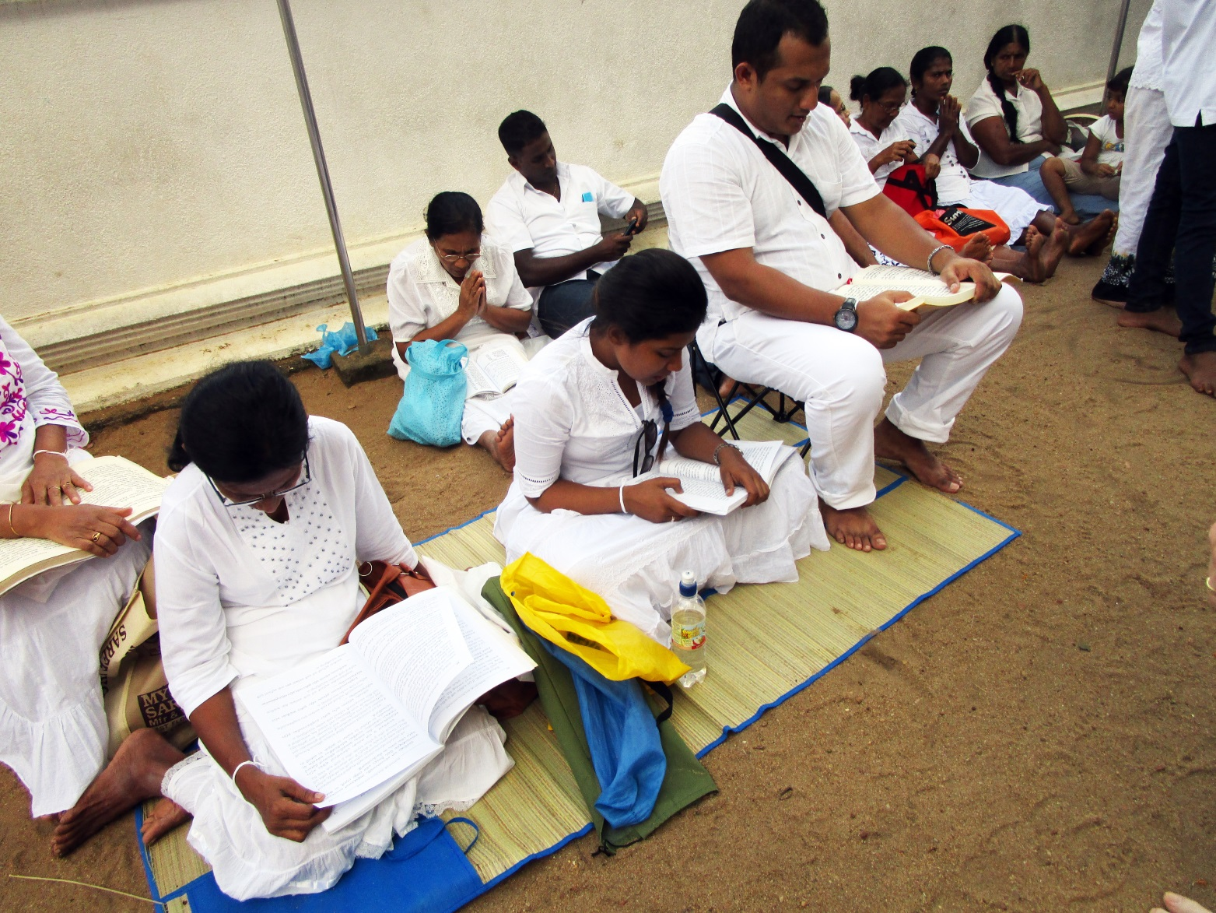
Lay Buddhist Practice
Chanting the Paritta (Sri Lanka)

Slide 20
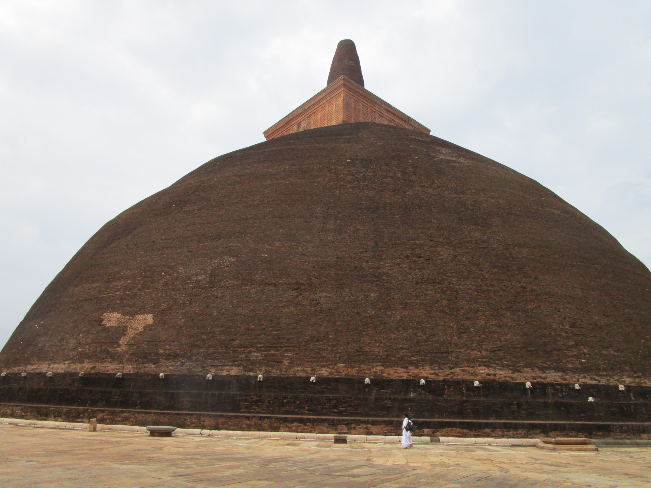
Lay Buddhist Practice
Circumabulation (Anuradapura, Sri Lanka, 1st c. BCE)

Slide 21
The Path of Purification
“O monks without having master the domain of morality (sila), it is not possible to master the domain of concentration (samadhi). Without having mastered the domain of concentration, it is not possible to master the domain of wisdom (sila).”
Sila > Samadhi > Panna

Slide 22
Sila (Morality)
The Five Precepts (All Buddhists)
Not to Kill
Not to Steal
Not to Engage in Sexual Misduct
Not to Lie
Not to Indulge in Drugs or Alcohol
The Additional Three Precepts (Just for Monks)
Not to Eat After Midday
Not to Indulge in Entertainments / Indulge the Body
Not to Lie on Luxurious Beds

Slide 23
Samadhi (Morality)
The 40 Objects of Concentration
10 Kasina (Earth Objects) – i.e., fire, colors, water
10 Foul Objects – corpses
10 Recollections – i.e., Buddha, Generosity, Death
4 Divine Abodes – Kindness, Compassion. Joy, Equanimity
1 Perception of the Loathsomeness of Food
1 Analysis of the Four Elements
Choosing the Right Object?

Slide 24
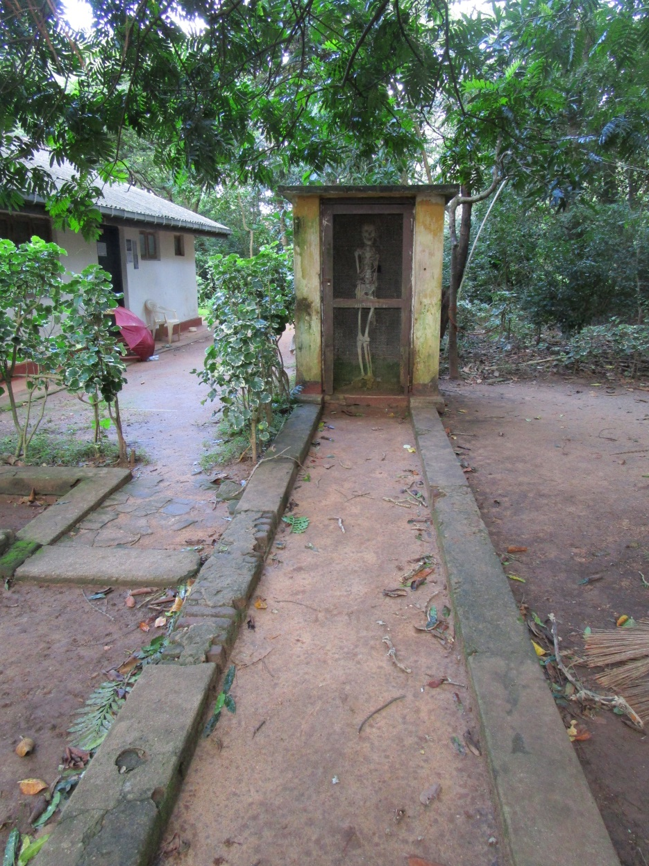
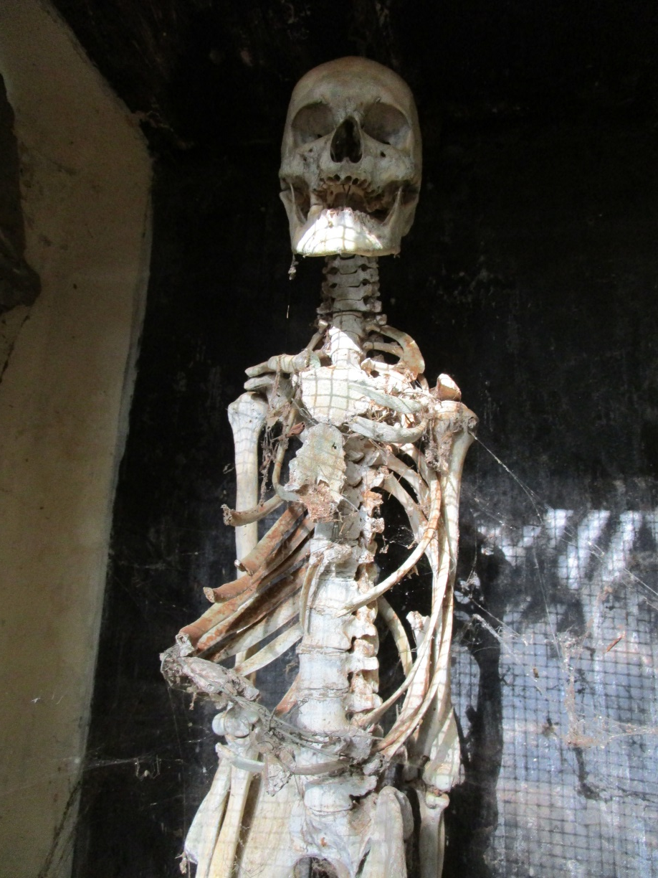
Samadhi: Meditation on Foulness

Slide 25
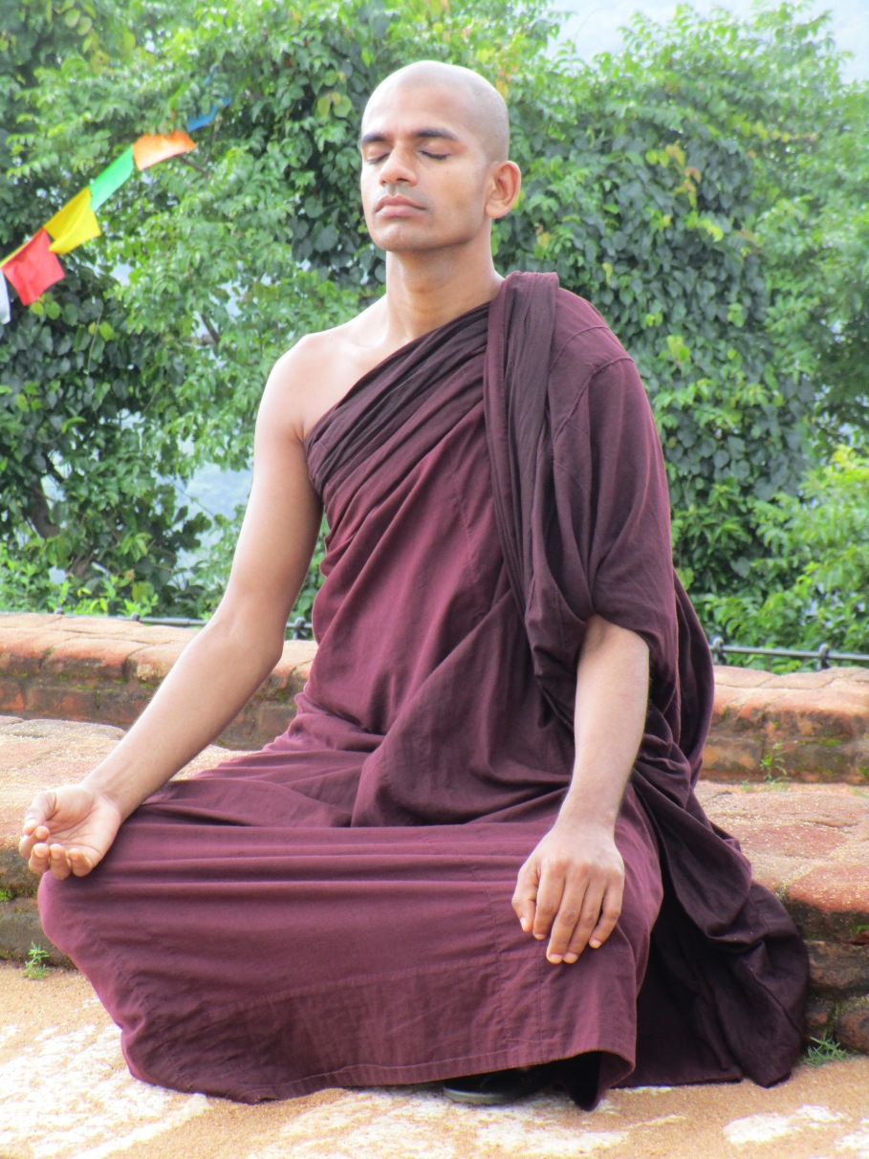
Samadhi: The Goal = Jhana

Slide 26
Vipassana (Mindfulness)
VI = in various way
PASSANA = to see
Concentration
&
Minfulness

